Slide 1

Predicting Cowpea Yield with Machine Learning
UNIVERSITY OF AGRICULTURAL SCIENCES ,
COLLEGE OF AGRICULTURE,
GKVK, BANGLORE
Presented by
Aishwarya Gandhi.M ~AMB2011
Bhoomika H R~AMB2038
Amrutha K ~AMB2015

Slide 2
Content
Introduction
Problem Statement
Motivation
Objectives of the project
Dataset Overview
Methodlogy/approach
Tools and Technologies Used
Results
Discussion / Analysis
Conclusion and Future Work
References/Acknowledgements

Slide 3
Introduction
• Brief Background / Context:
Cowpea is an important legume crop widely grown for its nutritional value and ability to fix nitrogen, but its yield depends on proper nutrient management.
• Agriculture Problem Area:
Farmers often face difficulty in determining the right amount of nitrogen fertilizer, leading to low yield or excessive input use.
• Importance of Data-Driven Approaches:
Machine learning helps analyze complex relationships between inputs and yield, enabling accurate predictions and better decision-making in farming.

Slide 4
Problem Statement
Predict cowpea crop yield using machine learning techniques
• Analyze the effect of nitrogen application and plant growth parameters on yield
• Develop accurate and reliable prediction models
• Compare different algorithms to identify the best-performing model
• Scope limited to a small experimental dataset with selected features

Slide 5
Motivation
Crop yield prediction is important for improving food production and farm efficiency
• Helps farmers determine optimal nitrogen usage and reduce input costs
• Supports better decision-making in crop management and resource allocation
• Useful in precision agriculture and smart farming practices
• Contributes to research and development in agricultural machine learning
• Promotes sustainable farming by reducing fertilizer overuse and environmental impact

Slide 6
Objectives of the Project
Gain knowledge in machine learning, data analysis, and data visualization
• Understand model training, evaluation, and performance metrics
• Identify patterns and relationships between input features and yield
• Generate accurate predictions and meaningful insights for farming decisions
Compare different algorithms to identify the best-performing model
Develop machine learning models to predict cowpea crop yield

Slide 7
Dataset Overview
Dataset Source: Experimental agronomic dataset (field experiment on cowpea)
• Number of Records and Features:
20 samples
3 input features + 1 target variable
• Types of Features:
Numerical features (nitrogen level, plant height, leaf area, yield)
Crop and growth-related parameters
• Preprocessing Steps:
Checked for missing values (none present)
Selected relevant input features
Removed categorical variables (treatment, replication)
Train-test split (80% training, 20% testing)

Slide 8
Methodology / Approach
Data Cleaning & Preprocessing
• Exploratory Data Analysis (EDA)
• Model / Algorithm Selection (Linear Regression, Decision Tree, Random Forest, ANN)
• Model Training and Validation (80% training, 20% testing)
• Evaluation Metrics: R² Score, MAE, RMSE
Workflow diagram illustrating the pipeline
Data loading → Feature selection → 80/20 train-test split
(random_state=42) → Model training → Evaluation with R², MAE, RMSE.

Slide 9
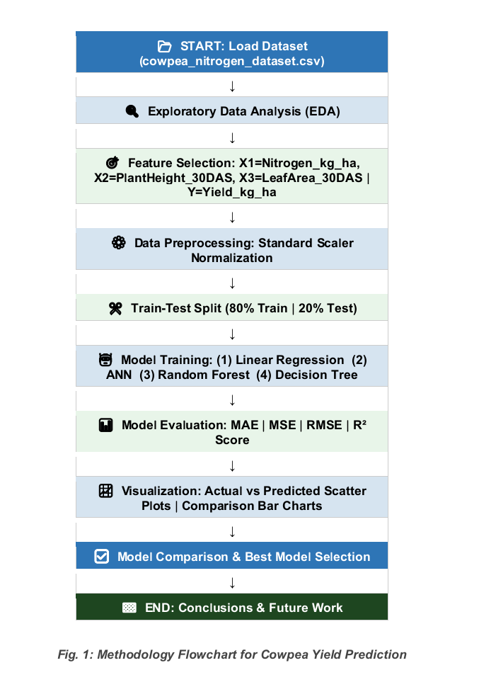

Slide 10
Tools and Technologies Used
Libraries Used:
scikit-learn
pandas
numpy
matplotlib
seaborn
• Development Environment:
Jupyter Notebook
Google Colab
Programming Language:
Python

Slide 11
Results
Model performance was evaluated using R² Score, MAE, and RMSE
Random forest achieved the best performance
R² Score = 0.9931
MAE = 18.54 kg/ha
RMSE = 19.48 kg/ha

Slide 12
Decision tree also performed well with high accuracy and better generalization
R² Score = 0.9898
• Linear Regression showed good prediction accuracy but could not capture non-linear trends
• ANN gave poor performance due to small dataset size and lack of normalization

Slide 13
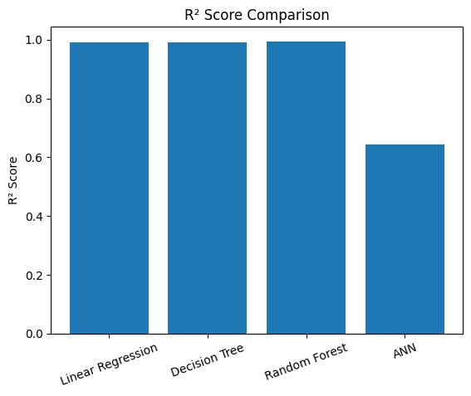
Fig.2 MAE Comparison Bar Chart — Compares Mean Absolute Error across all four models.
Random Forest and Decision Tree bars are shortest (MAE=9.71), while ANN bar is tallest

Slide 14
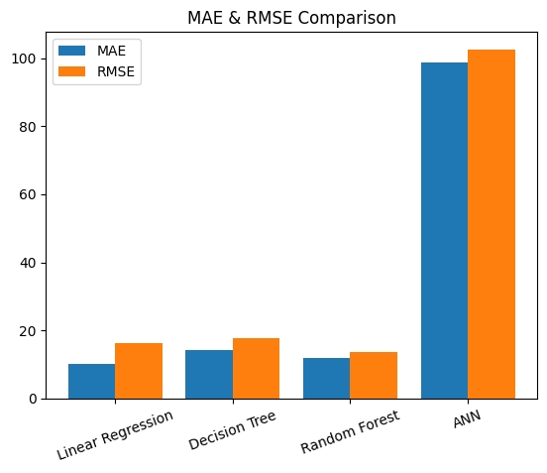
Fig..3 R² Score Comparison Bar Chart — All models except ANN exceed R²=0.99, with RF scoring highest at 0.9953. ANN's negative R² confirms it performs worse than a simple mean
predictor on this dataset.

Slide 15
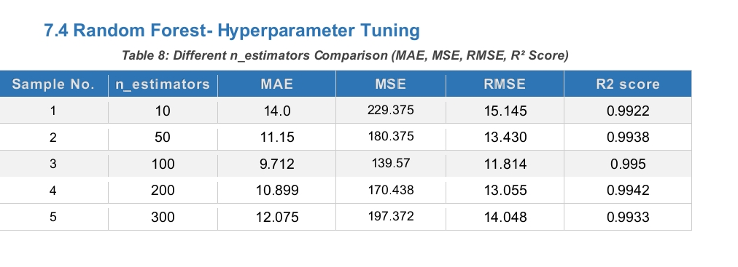

Slide 16
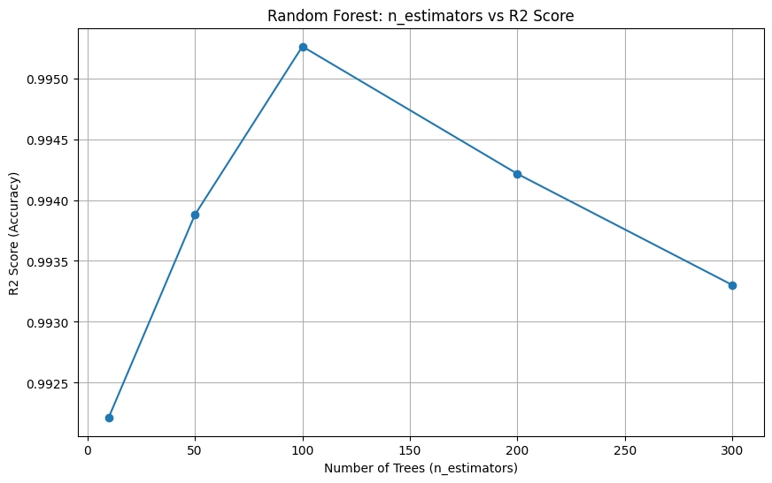
Fig 4:Random Forest:n_estimatores vs R2 Score

Slide 17
Visualizations Used: R² comparison bar graph MAE and RMSE comparison graph Actual vs Predicted Yield plots Nitrogen vs Yield curve Decision Tree structure and feature importance

Slide 18
Observations: Nitrogen level and leaf area are the most important factors affecting yield Yield increased with nitrogen up to 60 kg/ha and decreased at 80 kg/ha Tree-based models captured the non-linear relationship more effectively than ANN and Linear Regression

Slide 19
Discussion / Analysis
Nitrogen application and leaf area are the most influential factors affecting cowpea yield
Yield increases up to an optimal nitrogen level (60 kg/ha) and then declines
Tree-based models (Decision Tree, Random Forest) perform best for this dataset

Slide 20
Challenges Faced: Small dataset size (only 20 samples) Limited features considered for prediction ANN model did not converge properly Lack of feature scaling and hyperparameter tuning • Limitations: Dataset does not include factors like soil type, climate, irrigation, pests No cross-validation due to limited data Results may not generalize to larger or real-world datasets

Slide 21
Impact on Agriculture: Helps farmers optimize nitrogen usage for better yield Supports data-driven decision-making in farming Useful for precision agriculture and sustainable farming practices

Slide 22
Conclusion and Future Work
Machine learning models were successfully used to predict cowpea yield
Decision Tree and Random Forest showed highest accuracy and reliability
Optimal nitrogen level identified as 60 kg/ha for maximum yield
Leaf area and nitrogen are key factors influencing yield

Slide 23
Future Work:
Use larger and more diverse datasets (multi-location, multi-season)
Include additional features like soil type, weather, and irrigation
Apply advanced models (Deep Learning, ensemble techniques)
Develop real-time prediction systems for farmers
Practical Applications:
Helps farmers optimize fertilizer usage
Supports precision agriculture and smart farming
Improves yield prediction and decision-making

Slide 24
References / Acknowledgements
[1] Dharavath, R., Sharma, V., & Pandey, M. (2024). Multi-crop yield prediction using ensemble machine learning: A comparative study of Random Forest and XGBoost. Computers and Electronics in Agriculture, 217, 108620
[2]Patel, N., Gupta, S., & Verma, A. (2025). Hybrid LSTM and Random Forest approach for legume yield prediction using IoT sensor data. Agricultural Systems, 221, 104012.

